Slide 1
CS162 Operating Systems and Systems Programming Lecture 10 Monitors (Finished), Scheduling 1: Concepts and Classic Policies
February 22nd, 2022
Prof. Anthony Joseph and John Kubiatowicz
http://cs162.eecs.Berkeley.edu

Slide 2
Recall Two Uses of Semaphores
Mutual Exclusion (initial value = 1)
Also called “Binary Semaphore” or “mutex”.
Can be used for mutual exclusion, just like a lock:
semaP(&mysem); // Critical section goes here semaV(&mysem);
Scheduling Constraints (initial value = 0)
Allow thread 1 to wait for a signal from thread 2
thread 2 schedules thread 1 when a given event occurs
Example: suppose you had to implement ThreadJoin which must wait for thread to terminate:
Initial value of semaphore = 0
ThreadJoin { semaP(&mysem); }
ThreadFinish { semaV(&mysem); }

Slide 3

Recall Full Solution to Bounded Buffer (coke machine)
Semaphore fullSlots = 0; // Initially, no coke
Semaphore emptySlots = bufSize; // Initially, num empty slots
Semaphore mutex = 1; // No one using machine
Producer(item) { semaP(&emptySlots); // Wait until space semaP(&mutex); // Wait until machine free Enqueue(item); semaV(&mutex); semaV(&fullSlots); // Tell consumers there is // more coke }
Consumer() { semaP(&fullSlots); // Check if there’s a coke semaP(&mutex); // Wait until machine free item = Dequeue(); semaV(&mutex); semaV(&emptySlots); // tell producer need more return item; }
Critical sections using mutex protect integrity of the queue
fullSlots signals coke
emptySlots
signals space

Slide 4
Recall: Monitors and Condition Variables
Monitor: a lock and zero or more condition variables for managing concurrent access to shared data
Use of Monitors is a programming paradigm
Some languages like Java provide monitors in the language
Condition Variable: a queue of threads waiting for something inside a critical section
Key idea: allow sleeping inside critical section by atomically releasing lock at time we go to sleep
Contrast to semaphores: Can’t wait inside critical section
Operations:
Wait(&lock): Atomically release lock and go to sleep. Re-acquire lock later, before returning.
Signal(): Wake up one waiter, if any
Broadcast(): Wake up all waiters
Rule: Must hold lock when doing condition variable ops!

Slide 5
Recall: Structure of Mesa Monitor Program
Monitors represent the synchronization logic of the program
Wait if necessary
Signal when change something so any waiting threads can proceed
Basic structure of mesa monitor-based program:
lock while (need to wait) { condvar.wait(); } unlock do something so no need to wait lock
condvar.signal();
unlock
Check and/or update state variables
Wait if necessary
Check and/or update
state variables

Slide 6
Recall: Readers/Writers Problem
W
R
R
R
Motivation: Consider a shared database
Two classes of users:
Readers – never modify database
Writers – read and modify database
Is using a single lock on the whole database sufficient?
Like to have many readers at the same time
Only one writer at a time

Slide 7
Recall: Code for a Reader
Reader() { // First check self into system acquire(&lock);
while ((AW + WW) > 0) { // Is it safe to read? WR++; // No. Writers exist cond_wait(&okToRead,&lock);// Sleep on cond var WR--; // No longer waiting }
AR++; // Now we are active! release(&lock);
// Perform actual read-only access AccessDatabase(ReadOnly);
// Now, check out of system acquire(&lock); AR--; // No longer active if (AR == 0 && WW > 0) // No other active readers cond_signal(&okToWrite);// Wake up one writer release(&lock); }
Why Release the Lock here?

Slide 8
Recall: Code for a Writer
Writer() { // First check self into system acquire(&lock);
while ((AW + AR) > 0) { // Is it safe to write? WW++; // No. Active users exist cond_wait(&okToWrite,&lock); // Sleep on cond var WW--; // No longer waiting }
AW++; // Now we are active! release(&lock);
// Perform actual read/write access AccessDatabase(ReadWrite);
// Now, check out of system acquire(&lock); AW--; // No longer active if (WW > 0){ // Give priority to writers cond_signal(&okToWrite);// Wake up one writer } else if (WR > 0) { // Otherwise, wake reader cond_broadcast(&okToRead); // Wake all readers } release(&lock); }
Why broadcast() here instead of signal()?
Why Give priority to writers?

Slide 9
Questions
Can readers starve? Consider Reader() entry code:
while ((AW + WW) > 0) { // Is it safe to read? WR++; // No. Writers exist cond_wait(&okToRead,&lock);// Sleep on cond var WR--; // No longer waiting }
AR++; // Now we are active!
What if we erase the condition check in Reader exit?
AR--; // No longer active if (AR == 0 && WW > 0) // No other active readers cond_signal(&okToWrite);// Wake up one writer
Further, what if we turn the signal() into broadcast()
AR--; // No longer active cond_broadcast(&okToWrite); // Wake up sleepers
Finally, what if we use only one condition variable (call it “okContinue”) instead of two separate ones?
Both readers and writers sleep on this variable
Must use broadcast() instead of signal()

Slide 10
Use of Single CV: okContinue
Reader() { // check into system acquire(&lock);
while ((AW + WW) > 0) { WR++; cond_wait(&okContinue,&lock); WR--; }
AR++; release(&lock);
// read-only access AccessDbase(ReadOnly);
// check out of system acquire(&lock); AR--; if (AR == 0 && WW > 0) cond_signal(&okContinue); release(&lock); }
Writer() { // check into system acquire(&lock);
while ((AW + AR) > 0) { WW++; cond_wait(&okContinue,&lock); WW--; }
AW++; release(&lock);
// read/write access AccessDbase(ReadWrite);
// check out of system acquire(&lock); AW--; if (WW > 0){ cond_signal(&okContinue); } else if (WR > 0) { cond_broadcast(&okContinue); } release(&lock); }
What if we turn okToWrite and okToRead into okContinue (i.e. use only one condition variable instead of two)?

Slide 11
Use of Single CV: okContinue
Reader() { // check into system acquire(&lock);
while ((AW + WW) > 0) { WR++; cond_wait(&okContinue,&lock); WR--; }
AR++; release(&lock);
// read-only access AccessDbase(ReadOnly);
// check out of system acquire(&lock); AR--; if (AR == 0 && WW > 0) cond_signal(&okContinue); release(&lock); }
Writer() { // check into system acquire(&lock);
while ((AW + AR) > 0) { WW++; cond_wait(&okContinue,&lock); WW--; }
AW++; release(&lock);
// read/write access AccessDbase(ReadWrite);
// check out of system acquire(&lock); AW--; if (WW > 0){ cond_signal(&okContinue); } else if (WR > 0) { cond_broadcast(&okContinue); } release(&lock); }
Consider this scenario:
R1 arrives
W1, R2 arrive while R1 still reading → W1 and R2 wait for R1 to finish
Assume R1’s signal is delivered to R2 (not W1)

Slide 12
Use of Single CV: okContinue
Reader() { // check into system acquire(&lock);
while ((AW + WW) > 0) { WR++; cond_wait(&okContinue,&lock); WR--; }
AR++; release(&lock);
// read-only access AccessDbase(ReadOnly);
// check out of system acquire(&lock); AR--; if (AR == 0 && WW > 0) cond_broadcast(&okContinue); release(&lock); }
Writer() { // check into system acquire(&lock);
while ((AW + AR) > 0) { WW++; cond_wait(&okContinue,&lock); WW--; }
AW++; release(&lock);
// read/write access AccessDbase(ReadWrite);
// check out of system acquire(&lock); AW--; if (WW > 0 || WR > 0){ cond_broadcast(&okContinue); } release(&lock); }
Need to change to broadcast()!
Must broadcast() to sort things out!

Slide 13
Can we construct Monitors from Semaphores?
Locking aspect is easy: Just use a mutex
Can we implement condition variables this way?
Wait(Semaphore *thesema) { semaP(thesema); }
Signal(Semaphore *thesema) { semaV(thesema); }
Doesn’t work: Wait() may sleep with lock held
Does this work better?
Wait(Lock *thelock, Semaphore *thesema) { release(thelock); semaP(thesema); acquire(thelock); } Signal(Semaphore *thesema) {
semaV(thesema); }
No: Condition vars have no history, semaphores have history:
What if thread signals and no one is waiting? NO-OP
What if thread later waits? Thread Waits
What if thread V’s and noone is waiting? Increment
What if thread later does P? Decrement and continue

Slide 14
Construction of Monitors from Semaphores (con’t)
Problem with previous try:
P and V are commutative – result is the same no matter what order they occur
Condition variables are NOT commutative
Does this fix the problem?
Wait(Lock *thelock, Semaphore *thesema) { release(thelock); semaP(thesema); acquire(thelock); } Signal(Semaphore *thesema) { if semaphore queue is not empty semaV(thesema); }
Not legal to look at contents of semaphore queue
There is a race condition – signaler can slip in after lock release and before waiter executes semaphore.P()
It is actually possible to do this correctly
Complex solution for Hoare scheduling in book
Can you come up with simpler Mesa-scheduled solution?

Slide 15
C-Language Support for Synchronization
C language: Pretty straightforward synchronization
Just make sure you know all the code paths out of a critical section
int Rtn() { acquire(&lock); … if (exception) { release(&lock); return errReturnCode; } … release(&lock); return OK; }
Watch out for setjmp/longjmp!
Can cause a non-local jump out of procedure
In example, procedure E calls longjmp, poping stack back to procedure B
If Procedure C had lock.acquire, problem!
Proc A
Proc B
Calls setjmp
Stack growth
Proc C
acquire(&lock)
Proc D
Proc E
Calls longjmp

Slide 16
Concurrency and Synchronization in C
Harder with more locks
void Rtn() { lock1.acquire(); … if (error) { lock1.release(); return; }
…
lock2.acquire();
…
if (error) {
lock2.release()
lock1.release();
return;
}
…
lock2.release();
lock1.release(); }
Is goto a solution???
void Rtn() { lock1.acquire(); … if (error) { goto release_lock1_and_return; }
…
lock2.acquire();
…
if (error) {
goto release_both_and_return;
}
…
release_both_and_return:
lock2.release();
release_lock1_and_return:
lock1.release(); }

Slide 17
C++ Language Support for Synchronization
Languages with exceptions like C++
Languages that support exceptions are problematic (easy to make a non-local exit without releasing lock)
Consider:
void Rtn() { lock.acquire(); … DoFoo(); … lock.release(); } void DoFoo() { … if (exception) throw errException; … }
Notice that an exception in DoFoo() will exit without releasing the lock!

Slide 18
C++ Language Support for Synchronization (con’t)
Must catch all exceptions in critical sections
Catch exceptions, release lock, and re-throw exception: void Rtn() { lock.acquire(); try { … DoFoo(); … } catch (…) { // catch exception lock.release(); // release lock throw; // re-throw the exception } lock.release(); } void DoFoo() { … if (exception) throw errException; … }

Slide 19
Much better: C++ Lock Guards
#include <mutex>
int global_i = 0;
std::mutex global_mutex;
void safe_increment() {
std::lock_guard<std::mutex> lock(global_mutex);
…
global_i++;
// Mutex released when ‘lock’ goes out of scope
}

Slide 20
Python with Keyword
More versatile than we show here (can be used to close files, database connections, etc.)
lock = threading.Lock()
…
with lock: # Automatically calls acquire()
some_var += 1
…
# release() called however we leave block

Slide 21
Java synchronized Keyword
Every Java object has an associated lock:
Lock is acquired on entry and released on exit from a synchronized method
Lock is properly released if exception occurs inside a synchronized method
Mutex execution of synchronized methods (beware deadlock)
class Account { private int balance; // object constructor public Account (int initialBalance) { balance = initialBalance; } public synchronized int getBalance() { return balance; } public synchronized void deposit(int amount) { balance += amount; } }

Slide 22
Java Support for Monitors
Along with a lock, every object has a single condition variable associated with it
To wait inside a synchronized method:
void wait();
void wait(long timeout);
To signal while in a synchronized method:
void notify();
void notifyAll();

Slide 23
Administrivia
Still grading Midterm 1 (Sorry)0
Finishing soon!
Solutions are up
No major deadlines this week!

Slide 24
Goal for Today
if ( readyThreads(TCBs) ) {
nextTCB = selectThread(TCBs);
run( nextTCB );
} else {
run_idle_thread();
}
Discussion of Scheduling:
Which thread should run on the CPU next?
Scheduling goals, policies
Look at a number of different schedulers

Slide 25
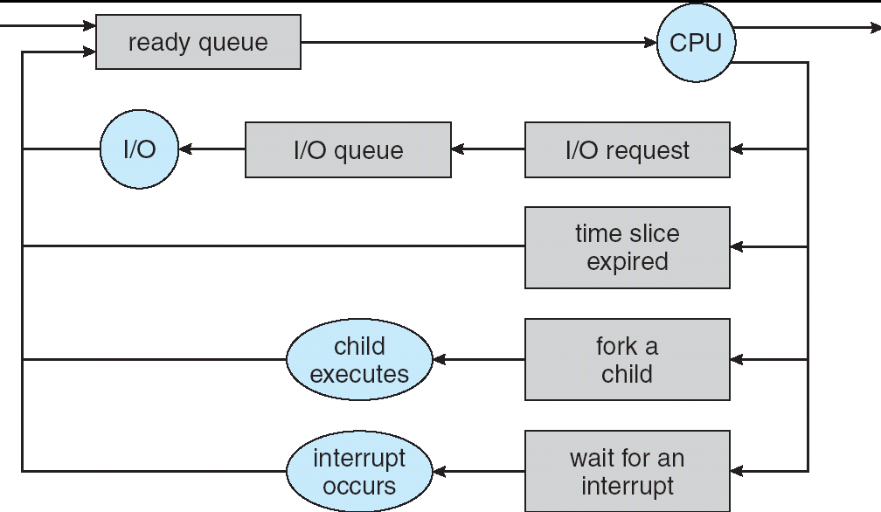
Recall: Scheduling
Question: How is the OS to decide which of several tasks to take off a queue?
Scheduling: deciding which threads are given access to resources from moment to moment
Often, we think in terms of CPU time, but could also think about access to resources like network BW or disk access

Slide 26
Scheduling: All About Queues

Slide 27
Scheduling Assumptions
CPU scheduling big area of research in early 70’s
Many implicit assumptions for CPU scheduling:
One program per user
One thread per program
Programs are independent
Clearly, these are unrealistic but they simplify the problem so it can be solved
For instance: is “fair” about fairness among users or programs?
If I run one compilation job and you run five, you get five times as much CPU on many operating systems
The high-level goal: Dole out CPU time to optimize some desired parameters of system
USER1
USER2
USER3
USER1
USER2
Time

Slide 28
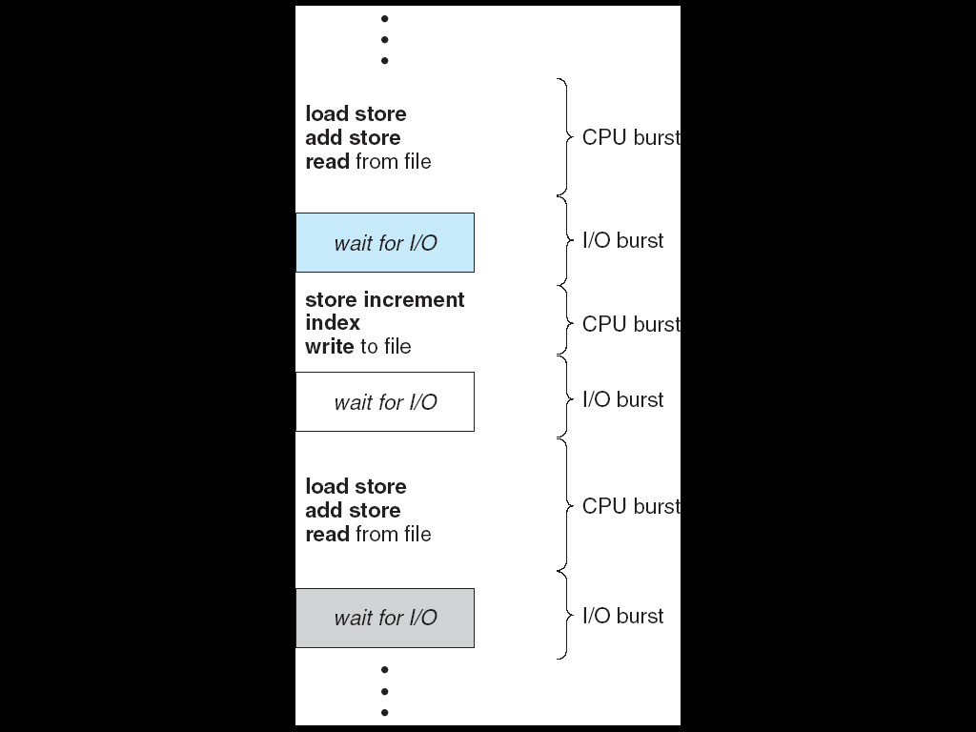
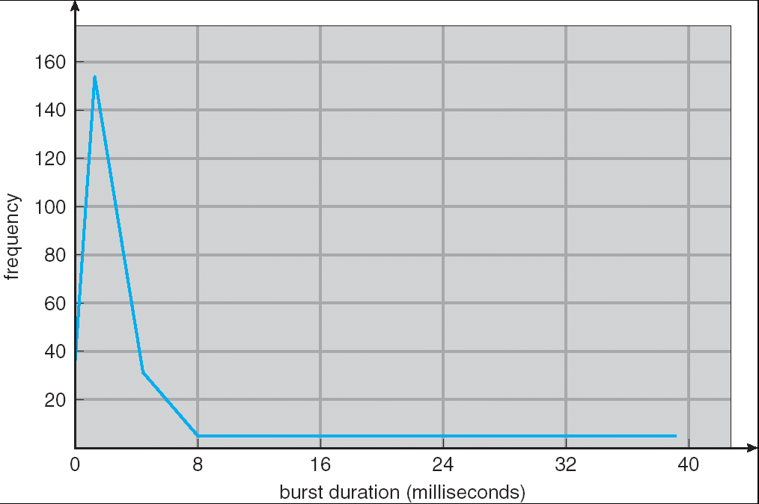
Assumption: CPU Bursts
Weighted toward small bursts
Execution model: programs alternate between bursts of CPU and I/O
Program typically uses the CPU for some period of time, then does I/O, then uses CPU again
Each scheduling decision is about which job to give to the CPU for use by its next CPU burst
With timeslicing, thread may be forced to give up CPU before finishing current CPU burst

Slide 29
Scheduling Policy Goals/Criteria
Minimize Response Time
Minimize elapsed time to do an operation (or job)
Response time is what the user sees:
Time to echo a keystroke in editor
Time to compile a program
Real-time Tasks: Must meet deadlines imposed by World
Maximize Throughput
Maximize operations (or jobs) per second
Throughput related to response time, but not identical:
Minimizing response time will lead to more context switching than if you only maximized throughput
Two parts to maximizing throughput
Minimize overhead (for example, context-switching)
Efficient use of resources (CPU, disk, memory, etc)
Fairness
Share CPU among users in some equitable way
Fairness is not minimizing average response time:
Better average response time by making system less fair
Notes:
What does CPU scheduling have to do with efficient use of the disk?
A lot! Have to have the CPU to make a disk request
Fairness: Minimize # of angry phone calls? Minimize my response time?

Slide 30
First-Come, First-Served (FCFS) Scheduling
First-Come, First-Served (FCFS)
Also “First In, First Out” (FIFO) or “Run until done”
In early systems, FCFS meant one program scheduled until done (including I/O)
Now, means keep CPU until thread blocks
Example: Process Burst Time P₁ 24 P₂ 3 P₃ 3
Suppose processes arrive in the order: P₁ , P₂ , P₃ The Gantt Chart for the schedule is:
Waiting time for P₁ = 0; P₂ = 24; P₃ = 27
Average waiting time: (0 + 24 + 27)/3 = 17
Average Completion time: (24 + 27 + 30)/3 = 27
Convoy effect: short process stuck behind long process
P₁
P₂
P₃
0
24
27
30

Slide 31
Convoy effect
Scheduled Task (process, thread)
time
Scheduling queue
arrivals
With FCFS non-preemptive scheduling, convoys of small tasks tend to build up when a large one is running.

Slide 32
FCFS Scheduling (Cont.)
Example continued:
Suppose that processes arrive in order: P2 , P3 , P1 Now, the Gantt chart for the schedule is:
Waiting time for P1 = 6; P2 = 0; P3 = 3
Average waiting time: (6 + 0 + 3)/3 = 3
Average Completion time: (3 + 6 + 30)/3 = 13
In second case:
Average waiting time is much better (before it was 17)
Average completion time is better (before it was 27)
FIFO Pros and Cons:
Simple (+)
Short jobs get stuck behind long ones (-)
Safeway: Getting milk, always stuck behind cart full of items! Upside: get to read about Space Aliens!
P₂
P₃
P₁
0
3
6
30

Slide 33
Round Robin (RR) Scheduling
FCFS Scheme: Potentially bad for short jobs!
Depends on submit order
If you are first in line at supermarket with milk, you don’t care who is behind you, on the other hand…
Round Robin Scheme: Preemption!
Each process gets a small unit of CPU time (time quantum), usually 10-100 milliseconds
After quantum expires, the process is preempted and added to the end of the ready queue.
n processes in ready queue and time quantum is q ⇒
Each process gets 1/n of the CPU time
In chunks of at most q time units
No process waits more than (n-1)q time units

Slide 34
RR Scheduling (Cont.)
Performance
q large ⇒ FCFS
q small ⇒ Interleaved (really small ⇒ hyperthreading?)
q must be large with respect to context switch, otherwise overhead is too high (all overhead)

Slide 35
Example of RR with Time Quantum = 20
Example: Process Burst Time P₁ 53 P₂ 8 P₃ 68 P₄ 24
The Gantt chart is:
Waiting time for P₁=(68-20)+(112-88)=72 P₂=(20-0)=20 P₃=(28-0)+(88-48)+(125-108)=85 P₄=(48-0)+(108-68)=88
Average waiting time = (72+20+85+88)/4=66¼
Average completion time = (125+28+153+112)/4 = 104½
Thus, Round-Robin Pros and Cons:
Better for short jobs, Fair (+)
Context-switching time adds up for long jobs (-)
P₁
P₂
P₃
P₄
P₁
P₃
P₄
P₁
P₃
P₃
0
20
28
48
68
88
108
112
125
145
153

Slide 36
Decrease Response Time
T₁: Burst Length 10
T₂: Burst Length 1
Q = 10
Average Response Time = (10 + 11)/2 = 10.5
Q = 5
Average Response Time = (6 + 11)/2 = 8.5
T₁
T₂
0
10
11
T₁
T₂
T₁
0
5
6
11

Slide 37
Same Response Time
T₁: Burst Length 1
T₂: Burst Length 1
Q = 10
Average Response Time = (1 + 2)/2 = 1.5
Q = 1
Average Response Time = (1 + 2)/2 = 1.5
T₁
T₂
0
1
2
T₁
T₂
0
1
2

Slide 38
Increase Response Time
T₁: Burst Length 1
T₂: Burst Length 1
Q = 1
Average Response Time = (1 + 2)/2 = 1.5
Q = 0.5
Average Response Time = (1.5 + 2)/2 = 1.75
T₁
T₂
0
1
2
0
2

Slide 39
How to Implement RR in the Kernel?
FIFO Queue, as in FCFS
But preempt job after quantum expires, and send it to the back of the queue
How? Timer interrupt!
And, of course, careful synchronization
Project 2: Scheduling

Slide 40
Round-Robin Discussion
How do you choose time slice?
What if too big?
Response time suffers
What if infinite (∞)?
Get back FIFO
What if time slice too small?
Throughput suffers!
Actual choices of timeslice:
Initially, UNIX timeslice one second:
Worked ok when UNIX was used by one or two people.
What if three compilations going on? 3 seconds to echo each keystroke!
Need to balance short-job performance and long-job throughput:
Typical time slice today is between 10ms – 100ms
Typical context-switching overhead is 0.1ms – 1ms
Roughly 1% overhead due to context-switching

Slide 41
Comparisons between FCFS and Round Robin
Assuming zero-cost context-switching time, is RR always better than FCFS?
Simple example: 10 jobs, each take 100s of CPU time RR scheduler quantum of 1s All jobs start at the same time
Completion Times:
Both RR and FCFS finish at the same time
Average response time is much worse under RR!
Bad when all jobs same length
Also: Cache state must be shared between all jobs with RR but can be devoted to each job with FIFO
Total time for RR longer even for zero-cost switch!
Job # | FIFO | RR
1 | 100 | 991
2 | 200 | 992
… | … | …
9 | 900 | 999
10 | 1000 | 1000

Slide 42
Earlier Example with Different Time Quantum
P₂
[8]
P₄
[24]
P₁
[53]
P₃
[68]
Best FCFS:
0
8
32
85
153
Quantum
P₁
P₂
P₃
P₄
Average
Wait
Time
Best FCFS
32
0
85
8
31¼
Q = 1
84
22
85
57
62
Q = 5
82
20
85
58
61¼
Q = 8
80
8
85
56
57¼
Q = 10
82
10
85
68
61¼
Q = 20
72
20
85
88
66¼
Worst FCFS
68
145
0
121
83½
Completion
Time
Best FCFS
85
8
153
32
69½
Q = 1
137
30
153
81
100½
Q = 5
135
28
153
82
99½
Q = 8
133
16
153
80
95½
Q = 10
135
18
153
92
99½
Q = 20
125
28
153
112
104½
Worst FCFS
121
153
68
145
121¾

Slide 43
Handling Differences in Importance: Strict Priority Scheduling
Priority 3
Job 1
Job 2
Job 3
Priority 2
Job 4
Priority 1
Priority 0
Job 5
Job 6
Job 7
Execution Plan
Always execute highest-priority runable jobs to completion
Each queue can be processed in RR with some time-quantum
Problems:
Starvation:
Lower priority jobs don’t get to run because higher priority jobs
Deadlock: Priority Inversion
Happens when low priority task has lock needed by high-priority task
Usually involves third, intermediate priority task preventing high-priority task from running
How to fix problems?
Dynamic priorities – adjust base-level priority up or down based on heuristics about interactivity, locking, burst behavior, etc…

Slide 44
Scheduling Fairness
What about fairness?
Strict fixed-priority scheduling between queues is unfair (run highest, then next, etc):
long running jobs may never get CPU
Urban legend: In Multics, shut down machine, found 10-year-old job ⇒ Ok, probably not…
Must give long-running jobs a fraction of the CPU even when there are shorter jobs to run
Tradeoff: fairness gained by hurting avg response time!

Slide 45
Scheduling Fairness
How to implement fairness?
Could give each queue some fraction of the CPU
What if one long-running job and 100 short-running ones?
Like express lanes in a supermarket—sometimes express lanes get so long, get better service by going into one of the other lines
Could increase priority of jobs that don’t get service
What is done in some variants of UNIX
This is ad hoc—what rate should you increase priorities?
And, as system gets overloaded, no job gets CPU time, so everyone increases in priority⇒Interactive jobs suffer

Slide 46
What if we Knew the Future?
Could we always mirror best FCFS?
Shortest Job First (SJF):
Run whatever job has least amount of computation to do
Sometimes called “Shortest Time to Completion First” (STCF)
Shortest Remaining Time First (SRTF):
Preemptive version of SJF: if job arrives and has a shorter time to completion than the remaining time on the current job, immediately preempt CPU
Sometimes called “Shortest Remaining Time to Completion First” (SRTCF)
These can be applied to whole program or current CPU burst
Idea is to get short jobs out of the system
Big effect on short jobs, only small effect on long ones
Result is better average response time
Notes:
Rich get richer, and poor get poorer = short jobs get through the system faster, long jobs take even longer

Slide 47
Discussion
SJF/SRTF are the best you can do at minimizing average response time
Provably optimal (SJF among non-preemptive, SRTF among preemptive)
Since SRTF is always at least as good as SJF, focus on SRTF
Comparison of SRTF with FCFS
What if all jobs the same length?
SRTF becomes the same as FCFS (i.e. FCFS is best can do if all jobs the same length)
What if jobs have varying length?
SRTF: short jobs not stuck behind long ones

Slide 48
Example to illustrate benefits of SRTF
A or B
C
C’s
I/O
C’s
I/O
C’s
I/O
Three jobs:
A, B: both CPU bound, run for week C: I/O bound, loop 1ms CPU, 9ms disk I/O
If only one at a time, C uses 90% of the disk, A or B could use 100% of the CPU
With FCFS:
Once A or B get in, keep CPU for two weeks
What about RR or SRTF?
Easier to see with a timeline

Slide 49
SRTF Example continued:
Disk Utilization:
9/201 ~ 4.5%
C
A
B
C
RR 100ms time slice
Disk Utilization:
~90% but lots of wakeups!
C’s
I/O
C’s
I/O
CABAB…
C
RR 1ms time slice
C’s
I/O
C’s
I/O
Disk Utilization:
90%
C
A
A
A
SRTF
C’s
I/O
C’s
I/O

Slide 50
SRTF Further discussion
Starvation
SRTF can lead to starvation if many small jobs!
Large jobs never get to run
Somehow need to predict future
How can we do this?
Some systems ask the user
When you submit a job, have to say how long it will take
To stop cheating, system kills job if takes too long
But: hard to predict job’s runtime even for non-malicious users
Bottom line, can’t really know how long job will take
However, can use SRTF as a yardstick for measuring other policies
Optimal, so can’t do any better
SRTF Pros & Cons
Optimal (average response time) (+)
Hard to predict future (-)
Unfair (-)

Slide 51
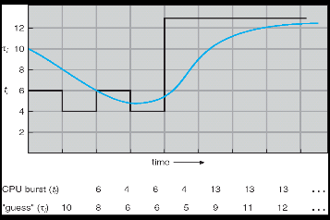
Predicting the Length of the Next CPU Burst
Adaptive: Changing policy based on past behavior
CPU scheduling, in virtual memory, in file systems, etc
Works because programs have predictable behavior
If program was I/O bound in past, likely in future
If computer behavior were random, wouldn’t help
Example: SRTF with estimated burst length
Use an estimator function on previous bursts: Let tn-1, tn-2, tn-3, etc. be previous CPU burst lengths. Estimate next burst τn = f(tn-1, tn-2, tn-3, …)
Function f could be one of many different time series estimation schemes (Kalman filters, etc)
For instance, exponential averaging τn = αtn-1+(1-α)τn-1 with (0<α≤1)

Slide 52
Lottery Scheduling
Yet another alternative: Lottery Scheduling
Give each job some number of lottery tickets
On each time slice, randomly pick a winning ticket
On average, CPU time is proportional to number of tickets given to each job
How to assign tickets?
To approximate SRTF, short running jobs get more, long running jobs get fewer
To avoid starvation, every job gets at least one ticket (everyone makes progress)
Advantage over strict priority scheduling: behaves gracefully as load changes
Adding or deleting a job affects all jobs proportionally, independent of how many tickets each job possesses

Slide 53
Lottery Scheduling Example (Cont.)
Lottery Scheduling Example
Assume short jobs get 10 tickets, long jobs get 1 ticket
What if too many short jobs to give reasonable response time?
If load average is 100, hard to make progress
One approach: log some user out
# short jobs/ # long jobs | % of CPU each short jobs gets | % of CPU each long jobs gets
1/1 | 91% | 9%
0/2 | N/A | 50%
2/0 | 50% | N/A
10/1 | 9.9% | 0.99%
1/10 | 50% | 5%

Slide 54
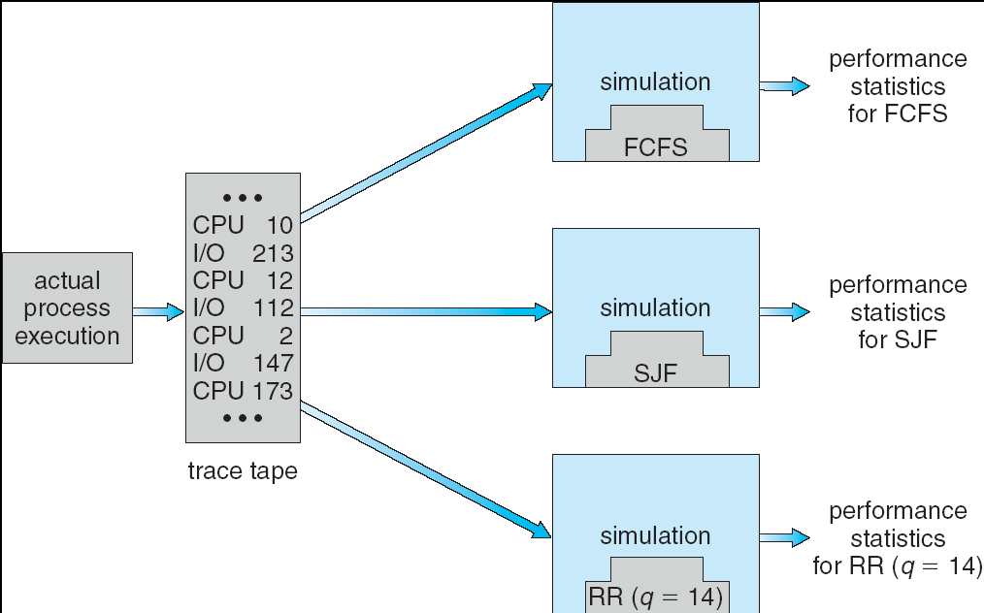
How to Evaluate a Scheduling algorithm?
Deterministic modeling
takes a predetermined workload and compute the performance of each algorithm for that workload
Queueing models
Mathematical approach for handling stochastic workloads
Implementation/Simulation:
Build system which allows actual algorithms to be run against actual data
Most flexible/general

Slide 55
How to Handle Simultaneous Mix of Diff Types of Apps?
Consider mix of interactive and high throughput apps:
How to best schedule them?
How to recognize one from the other?
Do you trust app to say that it is “interactive”?
Should you schedule the set of apps identically on servers, workstations, pads, and cellphones?
For instance, is Burst Time (observed) useful to decide which application gets CPU time?
Short Bursts ⇒ Interactivity ⇒ High Priority?
Assumptions encoded into many schedulers:
Apps that sleep a lot and have short bursts must be interactive apps – they should get high priority
Apps that compute a lot should get low(er?) priority, since they won’t notice intermittent bursts from interactive apps
Hard to characterize apps:
What about apps that sleep for a long time, but then compute for a long time?
Or, what about apps that must run under all circumstances (say periodically)

Slide 56
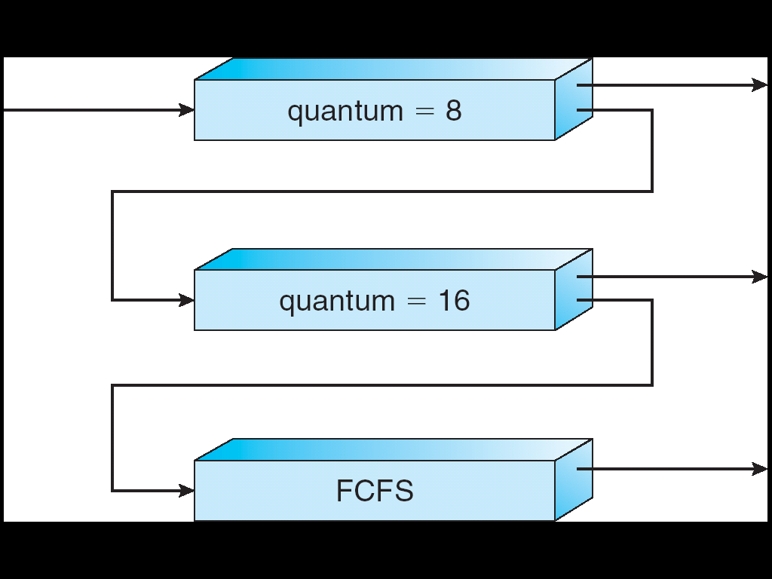
Multi-Level Feedback Scheduling
Another method for exploiting past behavior (first use in CTSS)
Multiple queues, each with different priority
Higher priority queues often considered “foreground” tasks
Each queue has its own scheduling algorithm
e.g. foreground – RR, background – FCFS
Sometimes multiple RR priorities with quantum increasing exponentially (highest:1ms, next: 2ms, next: 4ms, etc)
Adjust each job’s priority as follows (details vary)
Job starts in highest priority queue
If timeout expires, drop one level
If timeout doesn’t expire, push up one level (or to top)
Long-Running Compute Tasks Demoted to Low Priority

Slide 57
Scheduling Details
Long-Running Compute Tasks Demoted to Low Priority
Result approximates SRTF:
CPU bound jobs drop like a rock
Short-running I/O bound jobs stay near top
Scheduling must be done between the queues
Fixed priority scheduling:
serve all from highest priority, then next priority, etc.
Time slice:
each queue gets a certain amount of CPU time
e.g., 70% to highest, 20% next, 10% lowest

Slide 58
Scheduling Details
Long-Running Compute Tasks Demoted to Low Priority
Countermeasure: user action that can foil intent of the OS designers
For multilevel feedback, put in a bunch of meaningless I/O to keep job’s priority high
Of course, if everyone did this, wouldn’t work!
Example of Othello program:
Playing against competitor, so key was to do computing at higher priority the competitors.
Put in printf’s, ran much faster!

Slide 59
So, Does the OS Schedule Processes or Threads?
Many textbooks use the “old model”—one thread per process
Usually it's really: threads (e.g., in Linux)
One point to notice: switching threads vs. switching processes incurs different costs:
Switch threads: Save/restore registers
Switch processes: Change active address space too!
Expensive
Disrupts caching

Slide 60
Multi-Core Scheduling
Algorithmically, not a huge difference from single-core scheduling
Implementation-wise, helpful to have per-core scheduling data structures
Cache coherence
Affinity scheduling: once a thread is scheduled on a CPU, OS tries to reschedule it on the same CPU
Cache reuse

Slide 61
Recall: Spinlock
Spinlock implementation:
int value = 0; // Free
Acquire() { while (test&set(value)) {}; // spin while busy }
Release() { value = 0; // atomic store }
Spinlock doesn’t put the calling thread to sleep—it just busy waits
When might this be preferable?
For multiprocessor cache coherence: every test&set() is a write, which makes value ping-pong around in cache (using lots of memory BW)

Slide 62
Gang Scheduling and Parallel Applications
When multiple threads work together on a multi-core system, try to schedule them together
Makes spin-waiting more efficient (inefficient to spin-wait for a thread that’s suspended)
Alternative: OS informs a parallel program how many processors its threads are scheduled on (Scheduler Activations)
Application adapts to number of cores that it has scheduled
“Space sharing” with other parallel programs can be more efficient, because parallel speedup is often sublinear with the number of cores

Slide 63
A Final Word On Scheduling
When do the details of the scheduling policy and fairness really matter?
When there aren’t enough resources to go around
When should you simply buy a faster computer?
(Or network link, or expanded highway, or …)
One approach: Buy it when it will pay for itself in improved response time
Perhaps you’re paying for worse response time in reduced productivity, customer angst, etc…
Might think that you should buy a faster X when X is utilized 100%, but usually, response time goes to infinity as utilization⇒100%
An interesting implication of this curve:
Most scheduling algorithms work fine in the “linear” portion of the load curve, fail otherwise
Argues for buying a faster X when hit “knee” of curve
Response
time
100%
Utilization

Slide 64
Conclusion
Round-Robin Scheduling:
Give each thread a small amount of CPU time when it executes; cycle between all ready threads
Pros: Better for short jobs
Shortest Job First (SJF)/Shortest Remaining Time First (SRTF):
Run whatever job has the least amount of computation to do/least remaining amount of computation to do
Pros: Optimal (average response time)
Cons: Hard to predict future, Unfair
Multi-Level Feedback Scheduling:
Multiple queues of different priorities and scheduling algorithms
Automatic promotion/demotion of process priority in order to approximate SJF/SRTF
Lottery Scheduling:
Give each thread a priority-dependent number of tokens (short tasks⇒more tokens)

